Slide 1
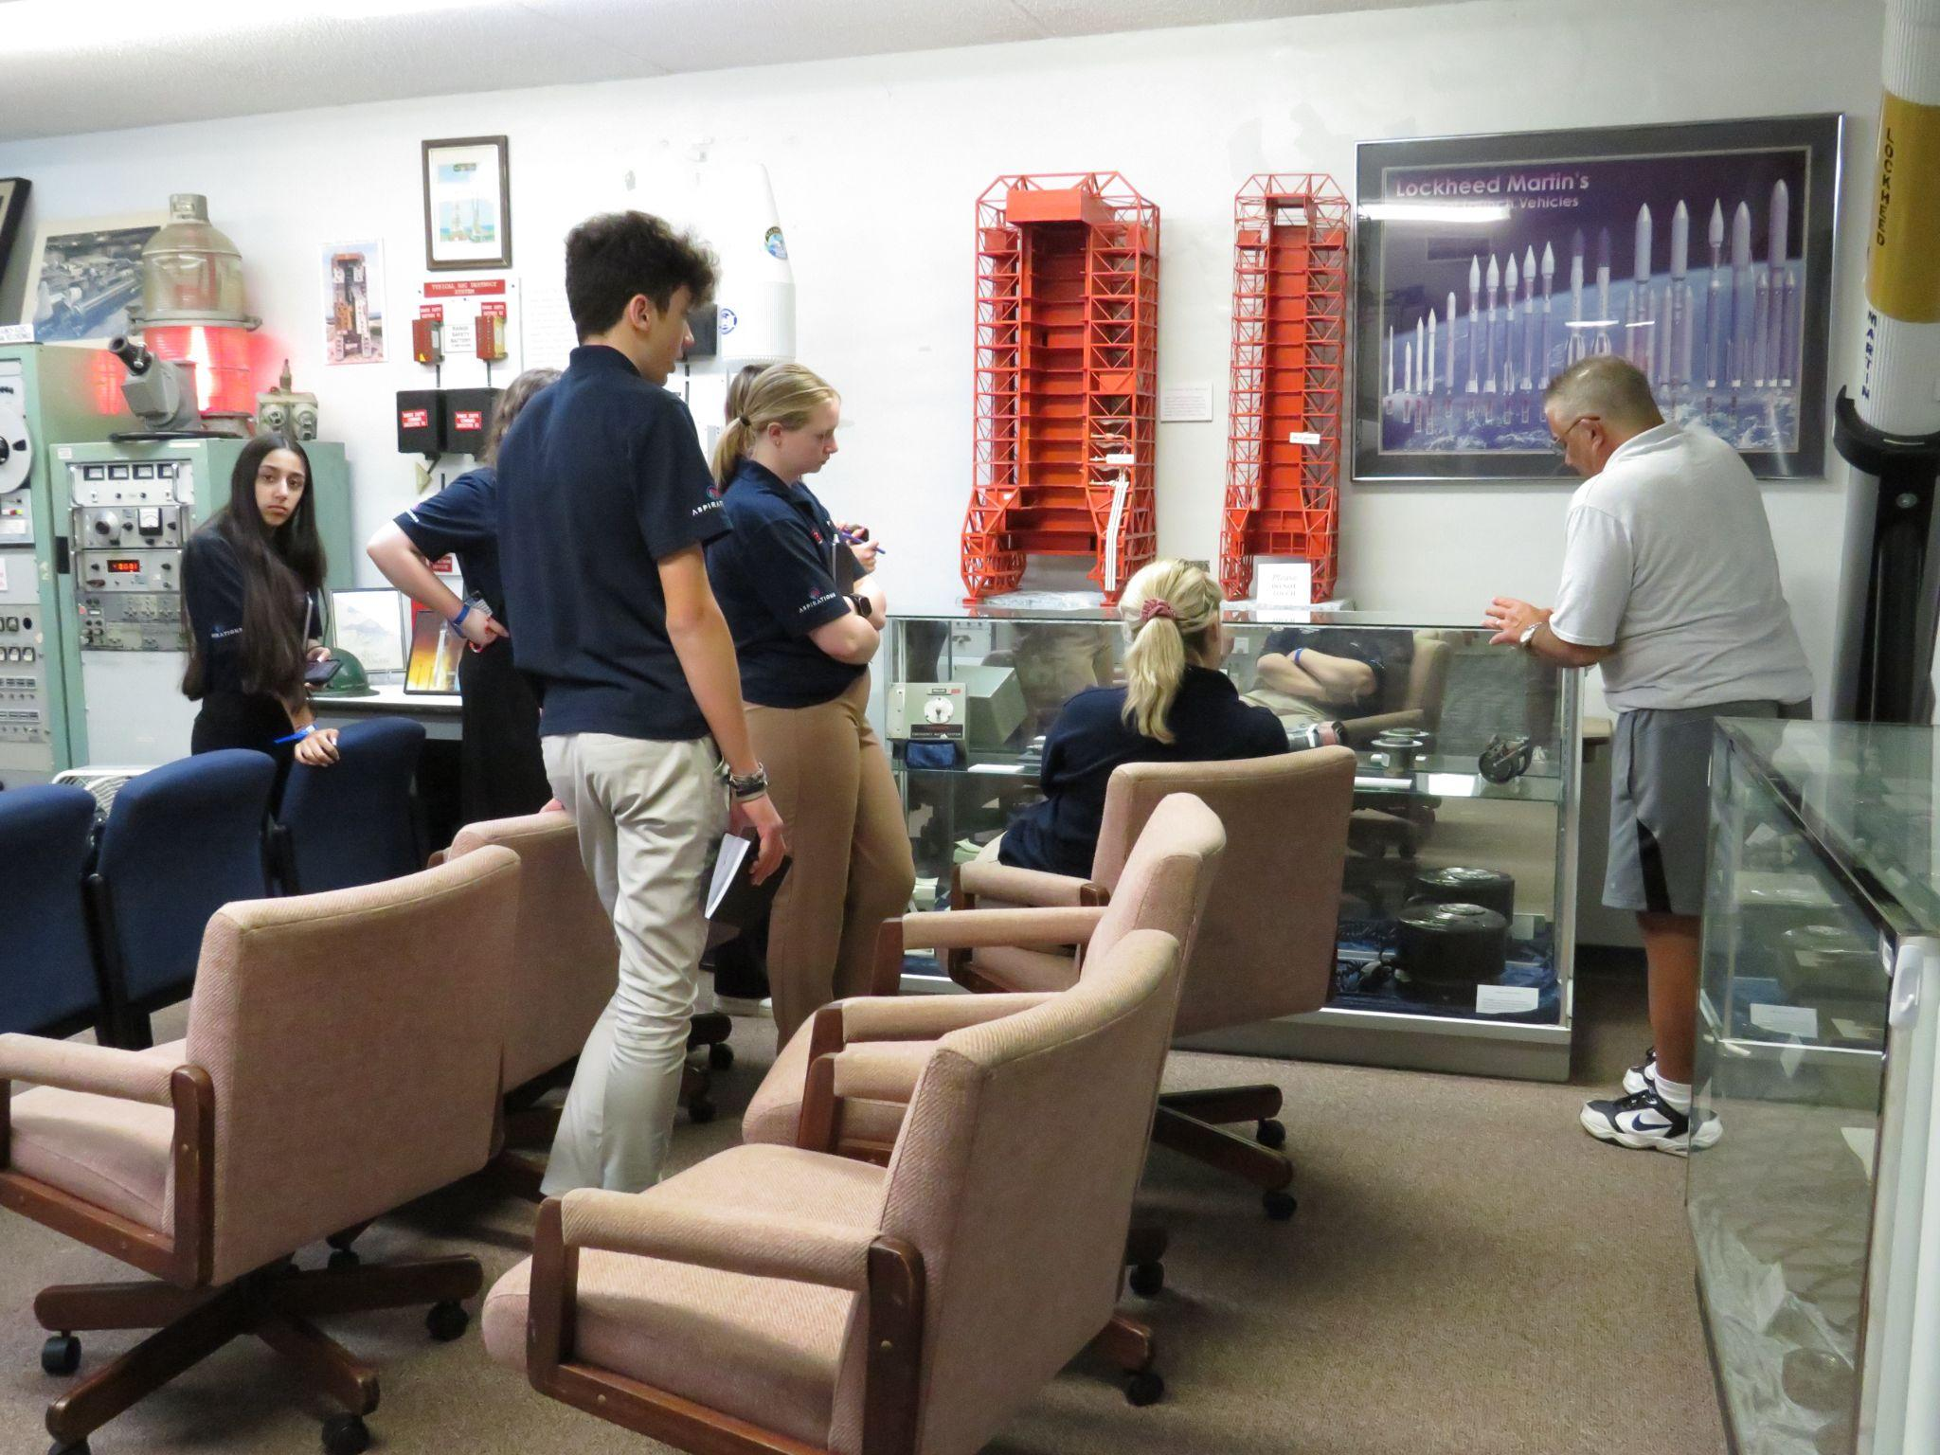
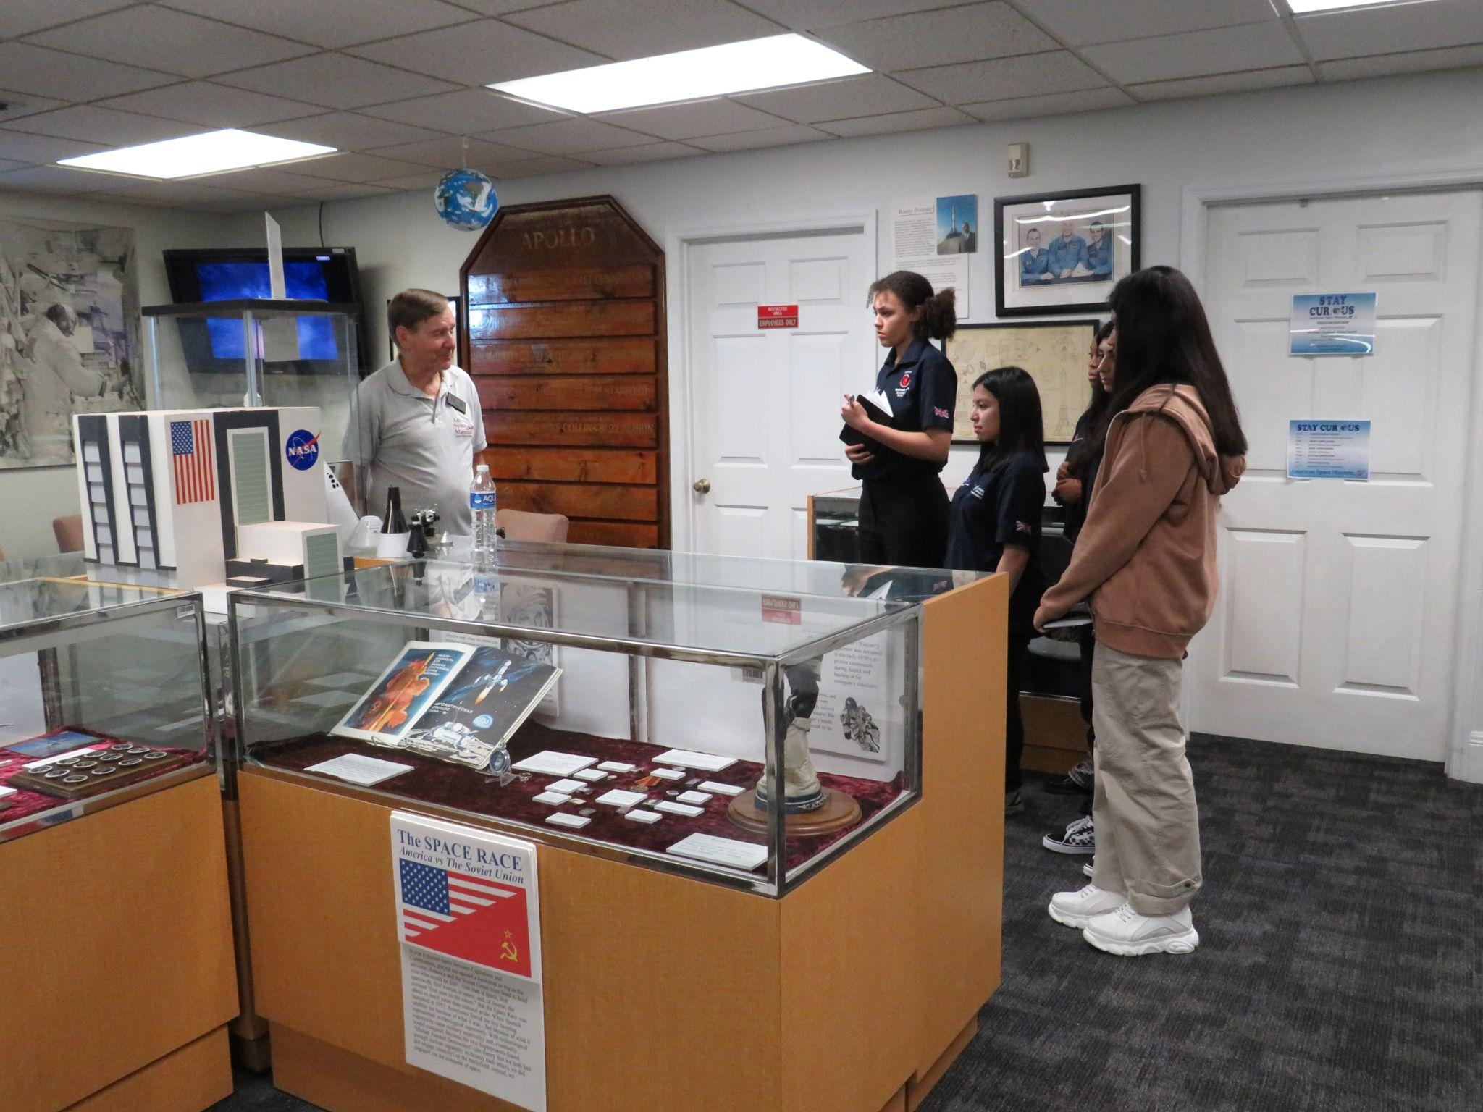
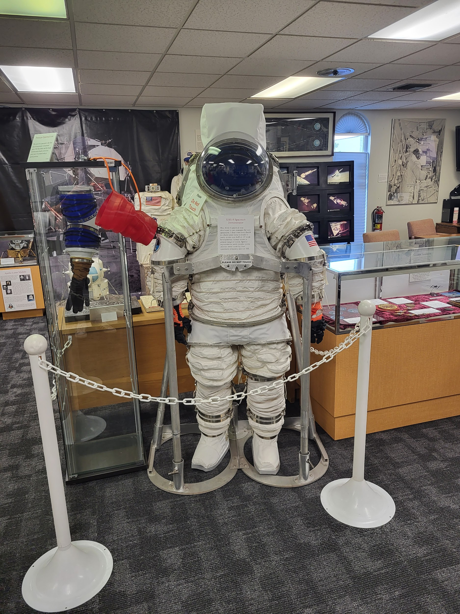
Wykham Park Academy: Andreea Okoye and Hrithika Ghai
So we started our morning with a debriefing with Mike who gave us a history on events such as World War 2, fireworks and gunpowder and how that related to rockets and the Space Race between Russia and the US. We then drove to the American Space Museum and had a personal statement workshop with Mike. He went into great detail about the importance of introducing ourselves and explained why it is so necessary to have a brief introduction that can interest people and make your personal statement stand out. Once we had finished with that workshop we then looked at everyone’s posters (made before the trip, about a variety of commercial space companies) and improved our work through an environment of criticism and conversation.
After lunch, half of the students got a tour of the museum by a man called Gordon Rebello while the other half of the students received a tour from Jim Tulley, who had worked at NASA for 20 years.
Tulley explained the obstacles facing Americans in reaching space (specifically orbit), while the Russians were not only beating them, but had sent a woman to space, Valentina Tereshkova, before Americans could get the first US man (John Glenn) into orbit in space. The main of these issues was Velocity: the velocity needed was 17,000 mph, which the US couldn’t reach.
He was knowledgeable of the entire process of the Gemini and Apollo missions and told recollections of the difficulties in space travel faced by astronauts like Dick Grayson, Neil Armstrong and Virgil Grissom. We were then able to use some of what we had learned to try and build a cardboard model in preparation for Thursday, when we would attend a middle school; working with students on their own rocket model.
We ended the day with a casual dinner with Andy Sokol, his wife (Chrissy) and his children. We spoke of American education and Andy’s journey through NASA, as well as his Snoopy Award. This was useful in introducing a new perspective to education and career, that wasn’t standard.

